Slide 1
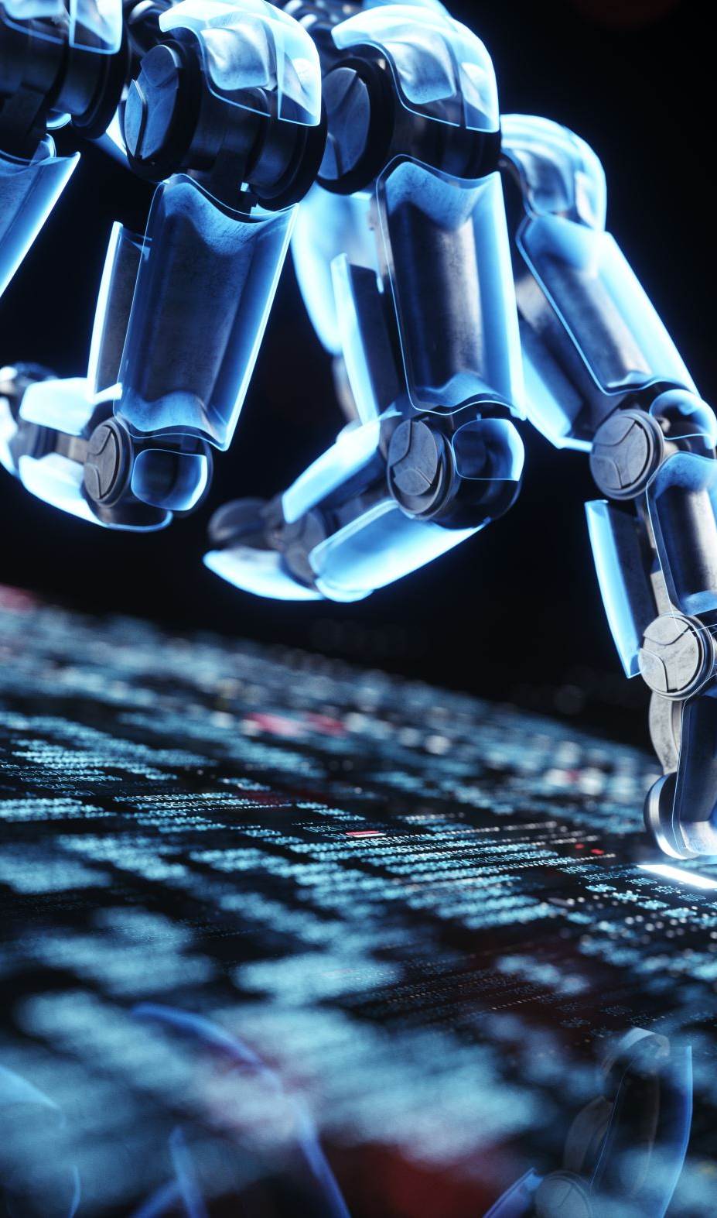
Computer Vision for Robotics 25RA611

Slide 2

What is Computer Vision?
Computer Vision enables machines and robots to see and understand images and videos.
It converts pixels into meaningful information.
As humans, we can correctly segment the object from its background.
Computer vision is a field of artificial intelligence (AI) that allows computers to see and understand the visual world.
Notes:
“

Slide 3
Human Vision vs Robot Vision
Human:
• Eyes capture images
• Brain understands
Robot:
• Camera captures images
• Computer Vision algorithms understand

Slide 4
Why Computer Vision is Important
Robots work in real-world environments
Environment is dynamic and unpredictable
Vision helps robots adapt and make decisions

Slide 5
Basic Computer Vision Pipeline
Image capture (camera)
Image processing
Feature extraction
Decision making
Robot action

Slide 6
Major Applications of Computer Vision
Face recognition
Autonomous vehicles
Medical imaging
Industrial automation
Surveillance systems

Slide 7
Role of Computer Vision in Robotics
Computer Vision acts as the eyes of the robot.
It helps in:
• Object detection
• Navigation
• Obstacle avoidance
• Interaction

Slide 8
Robotics Case Study 1: Line Following Robot
Camera detects black line on white surface.
Image processing extracts line.
Robot follows the path automatically.

Slide 9
Robotics Case Study 2: Obstacle Avoidance
Robot camera detects obstacles.
Distance and shape are estimated.
Robot changes path to avoid collision.

Slide 10
Robotics Case Study 3: Pick and Place Robot
Camera detects object position.
Computer Vision estimates coordinates.
Robot arm picks and places accurately.

Slide 11
Robotics Case Study 4: Autonomous Vehicle
Lane detection
Traffic sign recognition
Pedestrian detection
Real-time decision making

Slide 12
Why M.Tech Robotics Students Study CV
Core perception technology
Essential for autonomous robots
Strong industry demand
Foundation for AI and ML

Slide 13
Conclusion
Computer Vision gives robots the ability to see and understand the world.
It is a key technology in modern robotics.

